Slide 1
CH 2: Stack
2.1. Basic Concept of Stack, Stack as an ADT, Stack Operations, Stack Applications
2.2 Conversion from infix to postfix/prefix expression, Evaluation of postfix/ prefix
expressions

Slide 2
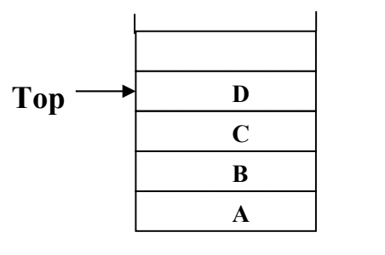
Introduction
A stack is an ordered collection of items into which new items may be inserted and from which items may be deleted at one end, called the top of the stack.
The deletion and insertion in a stack is done from top of the stack.
The following fig shows the stack containing items:

Slide 3

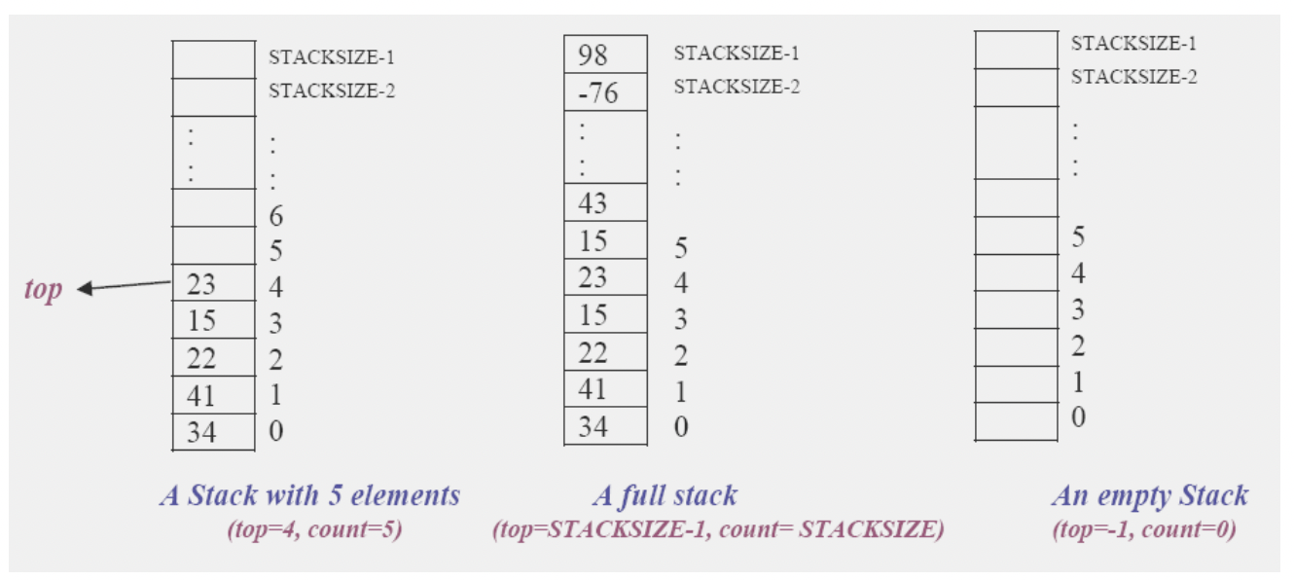
Introduction [2]
Intuitively, a stack is like a pile of plates where we can only (conveniently) remove a plate from the top and can only add a new plate on the top.
In computer science we commonly place numbers on a stack, or perhaps place records on the stack.

Slide 4
Applications of Stack
Stack is used directly and indirectly in the following fields:
To evaluate the expressions (postfix, prefix)
To keep the page-visited history in a Web browser
To perform the undo sequence in a text editor
Used in recursion
To pass the parameters between the functions in a C program
Can be used as an auxiliary data structure for implementing algorithms
Can be used as a component of other data structures

Slide 5
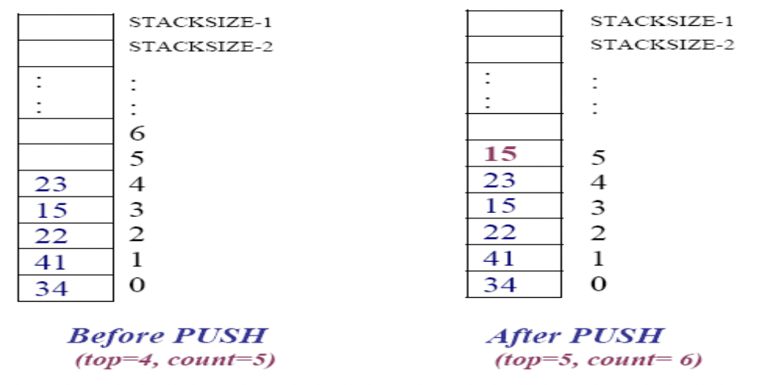
Stack Operation
The following operations can be performed on a stack:
PUSH operation: The push operation is used to add (or push or insert) elements in a stack
When we add an item to a stack, we say that we pushed it onto the stack.
The last item put into the stack is at the top.

Slide 6
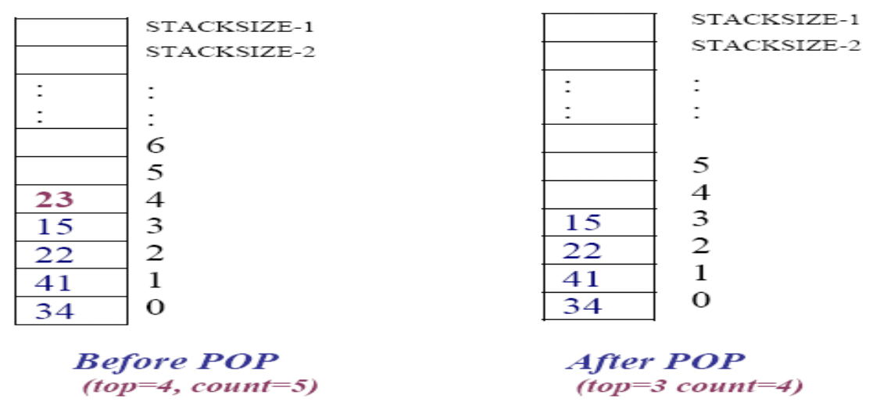
Stack Operation [2]
POP operation: The pop operation is used to remove or delete the top element from the stack.
When we remove an item, we say that we popped it from the stack.
When an item popped, it is always the top item which is removed.

Slide 7
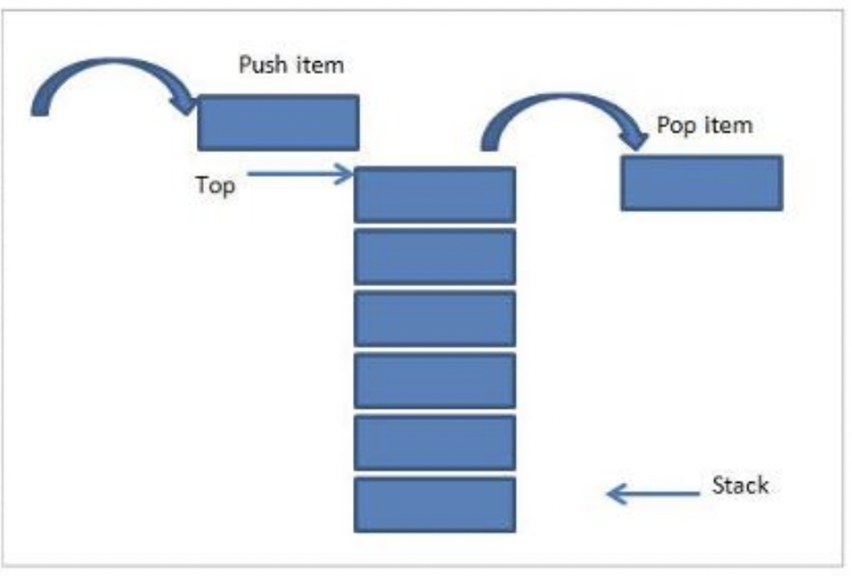

Slide 8
Stack Operation [3]
The PUSH and the POP operations are the basic or primitive operations on a stack.
Some others operations are:
CreateEmptyStack operation: This operation is used to create an empty stack.
IsFull operation: The isfull operation is used to check whether the stack is full or not ( i.e. stack overflow)
IsEmpty operation: The isempty operation is used to check whether the stack is empty or not. (i. e. stack underflow)
Top operations: This operation returns the current item at the top of the stack. However this operation doesn’t remove the current item.

Slide 9
Stack as an ADT
A stack of elements of type T is a finite sequence of elements of T together with the following operations:
CreateEmptyStack(S): Create or make stack S be an empty stack
Push(S, x): Insert x at one end of the stack, called its top
Top(S): If stack S is not empty; then retrieve the element at its top but don’t delete.
Pop(S): If stack S is not empty; then delete the element at its top
IsFull(S): Determine if S is full or not. Return true if S is full stack; return false otherwise
IsEmpty(S): Determine if S is empty or not. Return true if S is an empty stack; return false otherwise.

Slide 10
Stack Implementation
Steps:
Initially, we get empty stack. The top of an empty stack is set to -1.
Next, we push an element into the stack. The top of the stack will now point to the element just pushed.
Whenever, we push element into the stack, the top is incremented so as to point to the recent element.
Whenever a pop operation is performed, the top element is removed from the stack and top is decrement to point to the next element.
If the stack becomes empty, the top will be set to -1.

Slide 11
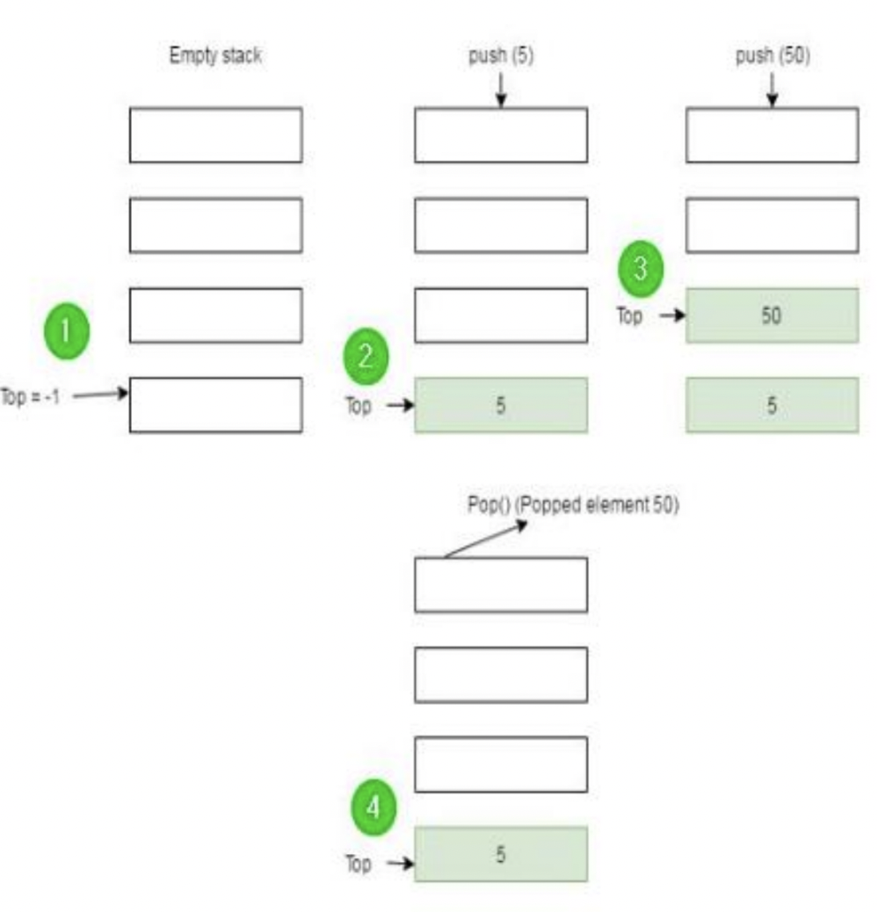
Stack Implementation [2]

Slide 12
Stack Implementation [3]
Using array - Static Stack Implementation
Using linked list - Dynamic Stack implementation
Static Stack Representation in C Dynamic Stack Representation in C
struct Stack{ struct Node{ Int top; int data; Int data[MAX]; struct Node *next; } }

Slide 13
Static Stack Implementation
Algorithm InitializeEmptyStack(S)
Start
Assign the value to top to -1. ie s->top = -1
Stop

Slide 14
Static Stack Implementation[2]
Algorithm isFull(S)
Start
Check if the top of S is equal to MAX-1, return true ie if(s->top == MAX-1) return true;
Else return false
Stop

Slide 15
Static Stack Implementation[3]
Algorithm isEmpty(S)
Start
Check if the top of S is equal to -1, return true ie if(s->top == -1) return true;
Else return false
Stop

Slide 16
Static Stack Implementation[4]
Algorithm push(S,x)
Start
Check if the S is full, 2.1. if full then display “Stack is full” and exit 2.2. Else, go to step 3
Increment top by 1 ie s->top += 1
Place the item x into “top” ie: s->items[s->top] = x
Stop

Slide 17
Static Stack Implementation[4]
Algorithm pop(S)
Start
Check if the S is empty, 2.1. if empty then display “Stack is empty” and exit 2.2. Else, go to step 3
Place the item at “top” to x ie: x = s->items[s->top]
Decrement top by 1 ie s->top -= 1
Stop

Slide 18
Dynamic Stack Implementation
Algorithm InitializeEmptyStack(S)
Start
Assign S to null pointer
Stop

Slide 19
Dynamic Stack Implementation[2]
Algorithm isFull(S)
Start
Try allocating a new node as new
If new is a valid pointer, then
3.1. free new
3.2. return false
Else if new is null, return true.
Stop

Slide 20
Dynamic Stack Implementation[3]
Algorithm isEmpty(S)
Start
Check if S is null,
If so, return true
Else if S is a valid pointer, return false.
Stop

Slide 21
Dynamic Stack Implementation[4]
Algorithm push(S,x)
Start
Check if S is full, if so then
2.1 display “Stack is full”
2.2 return
Allocate a new node as newNode with data as x.
Start with a node pointer p = S
Move p to next node until p->next != null
Set p->next = newNode.
Stop

Slide 22
Dynamic Stack Implementation[4]
Algorithm pop(S)
Start
Check if S is empty, if so then
2.1 display “Stack is empty”
2.2 return
Initialize a node pointer p = S
Set x = p->data and S = p->next
Delete p
Return the value of x
Stop

Slide 23
Infix, Prefix and Postfix Notation
One of the applications of the stack is to evaluate the arithmetic expression.
We can represent the arithmetic expressions following three types of notation:
Infix Prefix Postfix
Infix expression: It is an ordinary mathematical notation of expression where operator is written in between the operands. Example: A+B. Here ‘+’ is an operator and A and B are called operands
Prefix notation: In prefix notation the operator precedes the two operands. That is the operator is written before the operands. It is also called polish notation. Example: +AB
Postfix notation: In postfix notation the operators are written after the operands so it is called the postfix notation (post mean after). In this notation the operator follows the two operands. Example: AB+
Both prefix and postfix are parenthesis free expressions.

Slide 24
Infix, Prefix and Postfix Notation [2]
Examples: [find the types]
A + B
+ AB
AB +
(A + B) * C
* + A B C
A B + C *

Slide 25
Infix to Postfix Conversion
First convert the sub-expression to postfix that is to be evaluated first and repeat this process.
Substitute intermediate postfix sub-expression by any variable whenever necessary that makes it easy to convert.
To convert an infix expression to its postfix equivalent:
We first convert the innermost parentheses to postfix, resulting as a new operand
In this fashion parenthesis can be successively eliminated until the entire expression is converted
The last pair of parenthesis to be opened within a group of parenthesis encloses the first expression within the group to be transformed
This last in, first-out behavior suggests the use of a stack

Slide 26
Infix to Postfix Conversion [2]
Precedence rule:
While converting infix to postfix you have to consider the precedence rule, and the precedence rules are as follows:
Exponentiation ( the expression A$B is A raised to the B power, so that 3$2=9)
Multiplication/Division
Addition/Subtraction
When un-parenthesized operators of the same precedence are scanned, the order is assumed to be left to right except in the case of exponentiation, where the order is assumed to be from right to left.
A+B+C means (A+B)+C
A$B$C means A$(B$C)
By using parenthesis we can override the default precedence. Ex: A + (B* C).

Slide 27
Infix to Postfix Conversion [3]
Use the following rule to convert it in postfix:
1. Parenthesis for emphasis
2. Convert the multiplication
3. Convert the addition
4. Post-fix form

Slide 28
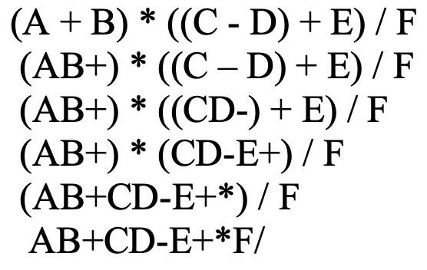
Infix to Postfix Conversion [4]
A + (B * C). Infix form
=>A + (B * C)
=>A + (BC*) Convert the Multiplication
=>A (BC*) + Convert the addition
=>ABC*+ Post-fix form

Slide 29
Infix to Postfix Conversion [4]
Algorithm:
Scan one character at a time of an infix expression from left to right
Opstack = the empty stack
Repeat till there is data in infix expression
if scanned character is ‘(‘ then push it to opstack
if scanned character is operand then push it to poststack
if scanned character is operator then if(opstack!=-1) while(precedence (opstack[otos])>precedence(scan character)) then pop and push it into poststack Otherwise push into opstack
if scanned character is ‘)’ then pop and push into poststack until ‘(‘ is not found and ignore both symbols
pop and push into poststack until opstack is not empty.
Return

Slide 30
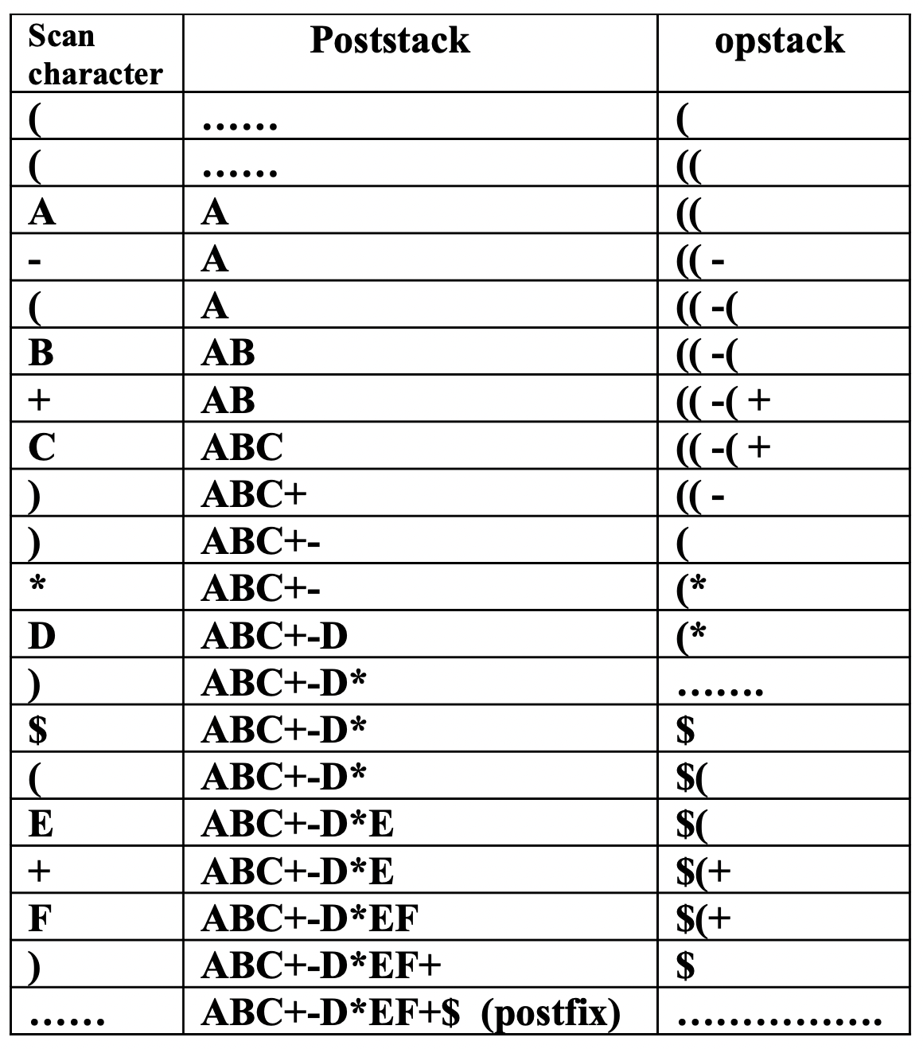
Infix to Postfix Conversion [5]
Algorithm Tracing: Infix Expression - ((A-(B+C))*D)$(E+F)

Slide 31
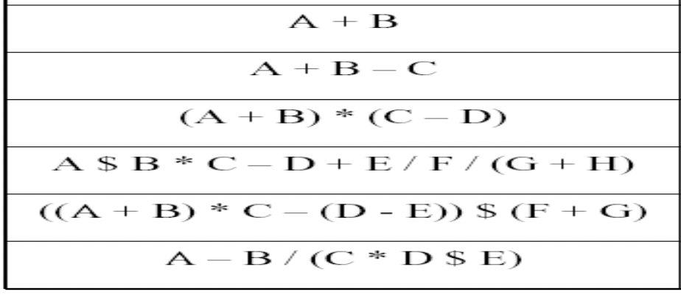
Infix to Postfix Conversion [5]
Convert the infix expression to postfix

Slide 32
Infix to prefix conversion
The precedence rule is same as that of previous case; only change is that the operator is placed before the operands rather than after them.
The prefix of
A+B-C is -+ABC.
Ex:
A+B-C (infix)
=>(+AB)-C
=> -+ABC (prefix)
Ex:
A $ B * C – D + E / F / (G + H)
=> A $ B * C – D + E / F /(+GH)
=> $AB* C – D + E / F /(+GH)
=> *$ABC-D+E/F/(+GH)
=> *$ABC-D+(/EF)/(+GH)
=> *$ABC-D+//EF+GH
=> (-*$ABCD) + (//EF+GH)
=> +-*$ABCD//EF+GH

Slide 33
Infix to prefix conversion[2]
Algorithm
Step 1: Reverse the infix expression. Note that while reversing the infix expression, the left and right parentheses are interchanged.
Step 2: Obtain the postfix expression of the input expression as obtained in [1].
Step 3: Reverse the postfix expression to obtain the prefix expression.

Slide 34
Infix to prefix conversion[3]
Ex: Infix expression: (A+B$C)*D+E$5
String reversal => 5$E+D*(C$B+A)
Obtaining the postfix expression of the given infix as:
5E$DCB$A+*+
Reverse the result to get prefix expression:
+*+A$BCD$E5

Slide 35
Infix to prefix conversion[4]
Obtain the prefix expression of the given expressions:

Slide 36
Evaluating postfix expression
Algorithm
Add the unique symbol # at the end of array pstack.
Scan the symbol of postfix expression one by one from the left to right.
Do the following with each symbol until # is encountered:
If the symbol is operand, push into stack.
If the symbol is operator, the pop last 2 elements of the stack and evaluate it as : Pstack[top-1] operator pstack[top] Push the result into the stack
Pop the element of the stack which will be the value of evaluation of postfix expression.

Slide 37
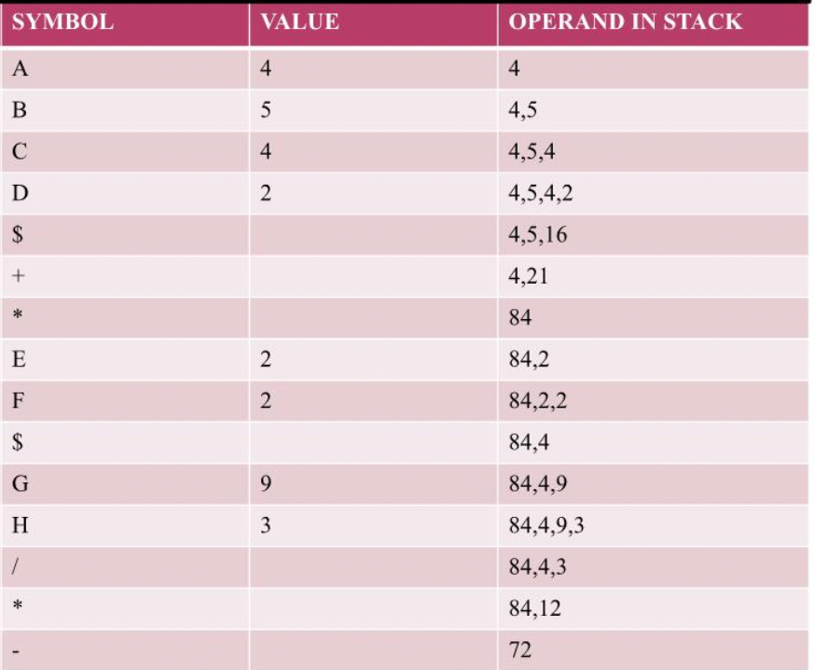
Evaluating postfix expression [2]
Ex: Evaluation of
ABCD$+*EF$GH/*-
Where A=4,B=5, C=4, D=2, E=2, F=2, G=9 & F=3
DO THIS:
123+*321-+* => ??

Slide 38
Evaluation of prefix expression
Algorithm:
Begin with initializing opndstack as an empty operand stack.
Scan infix expression one char at a time from right to left.
Do the following until no more characters in infix expressions.
If the scan char is operand, push it to opndstack
If the scan char is operator, pop opndstack[top] and opndstack[top-1] and perform the specified operation as: Opndstack[top] operator opndstack[top-1] Push the result into stack
Pop opndstack and display the required value.

Slide 39
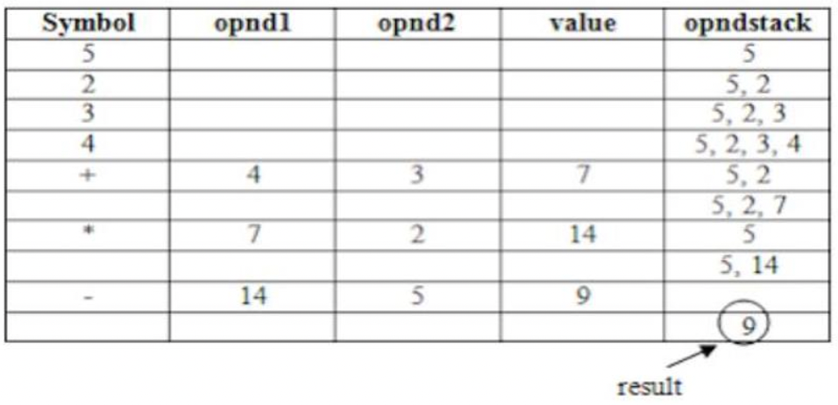
Evaluation of prefix expression[2]
Ex: -*+4325 Do THIS: / + 5 3 – 4 2

Slide 40
Check for balancing of parenthesis
Algorithm:
Declare a character stack S as empty stack.
Now traverse the expression string from left to right.
If the current character is a starting parenthesis (‘(‘ or ‘{‘ or ‘[‘) then push it to S.
If the current character is a closing bracket (‘)’ or ‘}’ or ‘]’) then pop from stack and if the popped character is the matching starting bracket then ok, else brackets are not balanced.
After complete traversal, if there is some starting bracket left in stack then “not balanced”

Slide 41
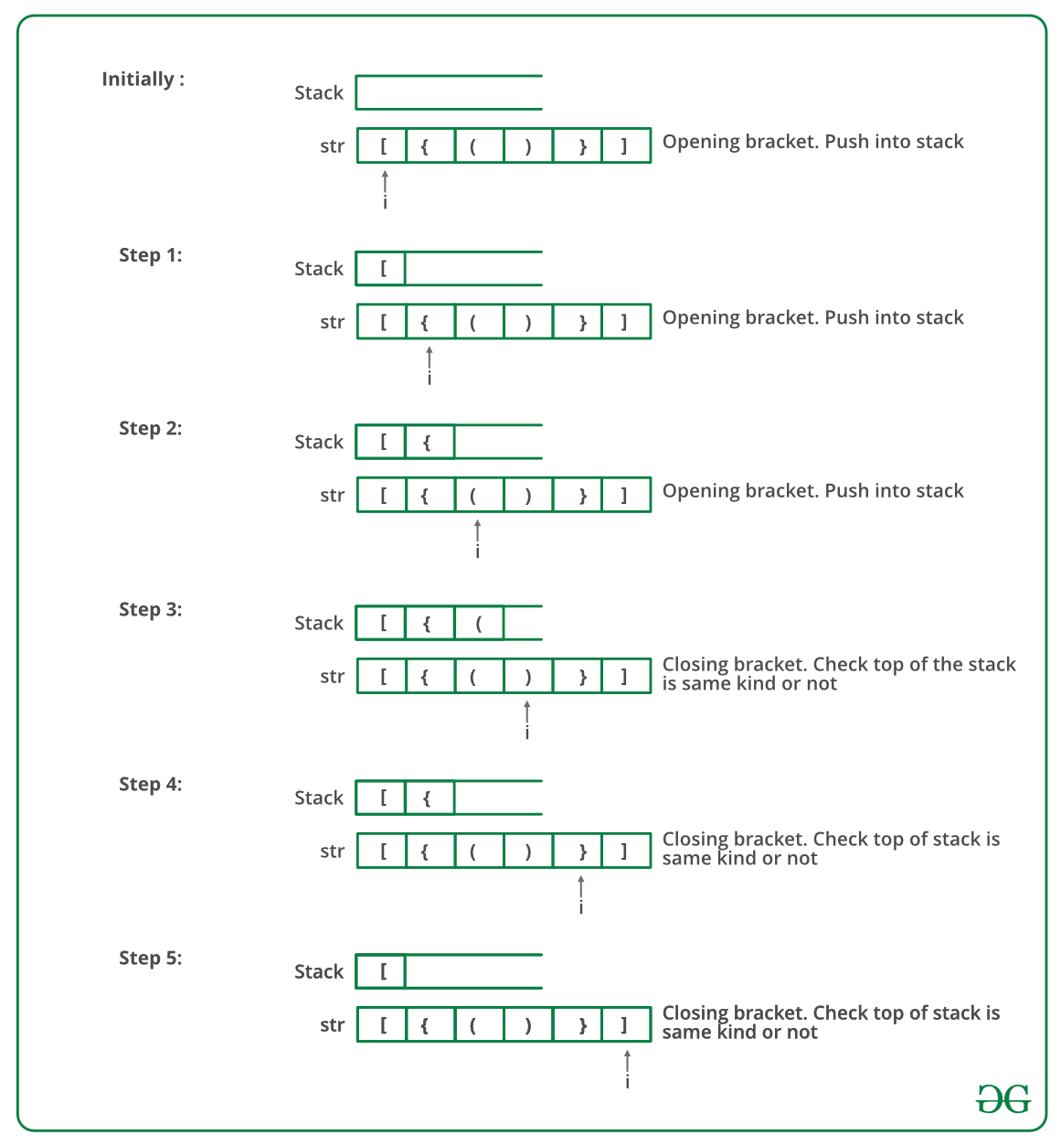
Check for balancing of parenthesis[2]

